Slide 1


Seyed Javad Miraftabzadeh
28th Sep 2022

Slide 2

Outline
Executive Summary
Introduction
Methodology
Results
Conclusion
Appendix

Slide 3
Executive Summary
Summary of methodologies
Data Collection through API
Data Collection with Web Scraping
Data Wrangling
Exploratory Data Analysis with SQL
Exploratory Data Analysis with Data Visualization
Interactive Visual Analytics with Folium
Machine Learning Prediction
Summary of all results
Exploratory Data analysis result
Interactive analytics in screenshots
Predictive Analytics result

Slide 4
Introduction
Project background and context
SpaceX announces the launch of the Falcon 9 rocket on its website at 62 million dollars. Other providers charge more than $165 million per launch. The major part of SpaceX's savings is because Space X can reuse the first stage. So, if we can determine if the first stage landed correctly, we can calculate the cost of the launch. We can use this information in the rival company against SpaceX to launch rockets. The goal of this project is to create a machine learning pipeline to predict the success of the first stage.
Problems you want to find answers
What factors determine if the rocket will land successfully?
The interaction amongst various features that determine the success rate of a successful landing.
What operating conditions needs to be in place to ensure a successful landing program.

Slide 5

Section 1

Slide 6
Methodology
Executive Summary
Data collection methodology:
Data was collected using SpaceX API and web scraping from Wikipedia.
Perform data wrangling
One-hot encoding was applied to categorical features
Perform exploratory data analysis (EDA) using visualization and SQL
Perform interactive visual analytics using Folium and Plotly Dash
Perform predictive analysis using classification models
We use these models: logistic regression, support vector machine, decision tree classifier, k nearest neighbors and measure the accuracy of theme at the end

Slide 7
Data Collection
The data was collected in various methods
Data collection was done using get request to the SpaceX API.
We decoded the response content as a Json using .json() function call and turn it into a pandas DataFrame using .json_normalize().
We then cleaned the data, and filter theme to only include Falcon 9 data, and dealing for missing values and fill in missing values where necessary.
After these we save the data in csv format.
In second step, we performed web scraping from Wikipedia for Falcon 9 launch records with BeautifulSoup.
The objective was to extract the launch records as HTML table, parse the table and convert it to a pandas DataFrame for future analysis.
After these we save the data in csv format.

Slide 8
Data Collection – SpaceX API
Request and parse the SpaceX launch data using the GET request
Filter the DataFrame to only include Falcon 9 launches
Dealing with Missing Values
GitHub URL:
https://github.com/miraftab/IBM_Applied_Data_Science_Capstone/blob/main/01_jupyter-labs-spacex-data-collection-api.ipynb
Get Data
Create helper functions
GET request to API
Filter Data
Create filter
Apply filter to DataFrame
Missing Values
Calculate mean for columns
Replace Nan with mean
Check Status Code
Json_normalize()
Check for Nan or Null

Slide 9
Data Collection - Scraping
Create Helper Functions
GET request for pages
Create Soup
Show soup attributes like title
Column Names from table headers
Create a data frame by parsing the launch HTML tables
Request the Falcon9 Launch Wiki page
Create DataFrame by Parsing data with Beautifull Soup
GitHub URL:
https://github.com/miraftab/IBM_Applied_Data_Science_Capstone/blob/main/02_jupyter-labs-webscraping.ipynb

Slide 10
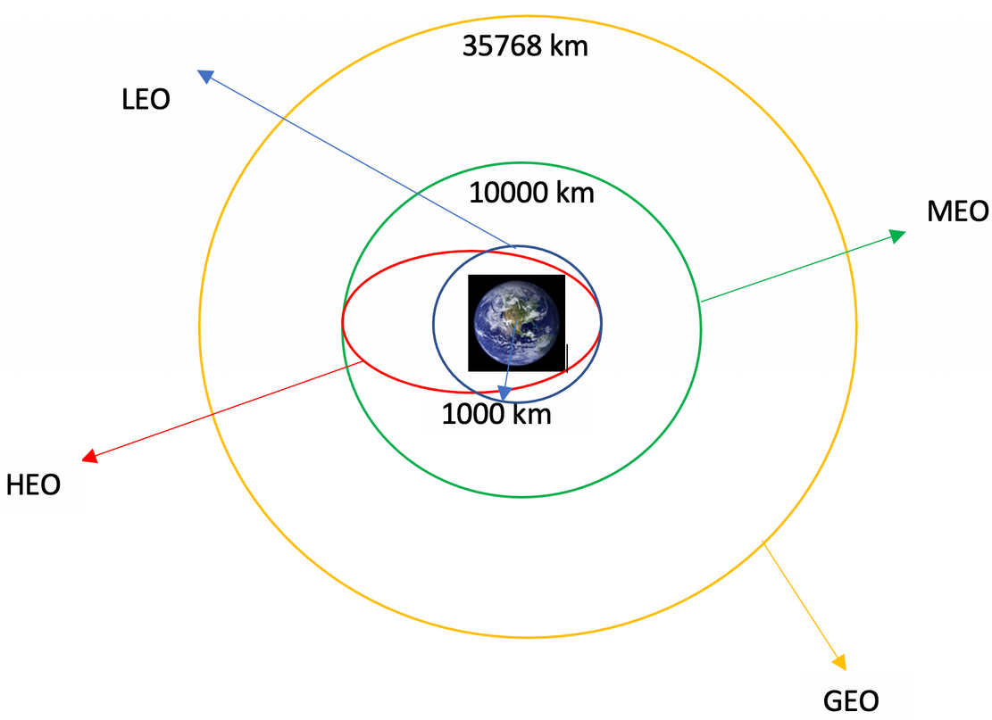
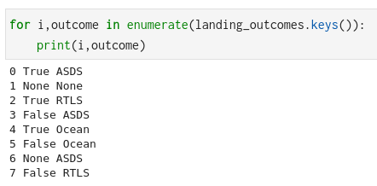
Data Wrangling
Calculate the number of launches on each site
Calculate the number and occurrence of each orbit
Calculate the number and occurrence of mission outcome per orbit type
Create a landing outcome label from Outcome column
Save result in CSV file for later use.
Github URL: https://github.com/miraftab/IBM_Applied_Data_Science_Capstone/blob/main/03_labs-jupyter-spacex-Data%20wrangling.ipynb

Slide 11
EDA with SQL
Load data in SQL DB and execute following queries
Display the names of the unique launch sites
Display 5 records where launch sites begin with the string 'CCA'
Display the total payload mass carried by boosters launched by NASA (CRS)
Display average payload mass carried by booster version F9 v1.1
List the date when the first succesful landing outcome in ground pad was acheived.
List the names of the boosters which have success in drone ship and have payload mass greater than 4000 but less than 6000
List the total number of successful and failure mission outcomes
List the names of the booster_versions which have carried the maximum payload mass. Use a subquery
List the records which will display the month names, failure landing ... for the months in year 2015.
Rank the count of successful landing between the date 04-06-2010 and 20-03-2017 I
GitHub URL: https://github.com/miraftab/IBM_Applied_Data_Science_Capstone/blob/main/04_jupyter-labs-eda-sql-coursera_sqllite.ipynb

Slide 12
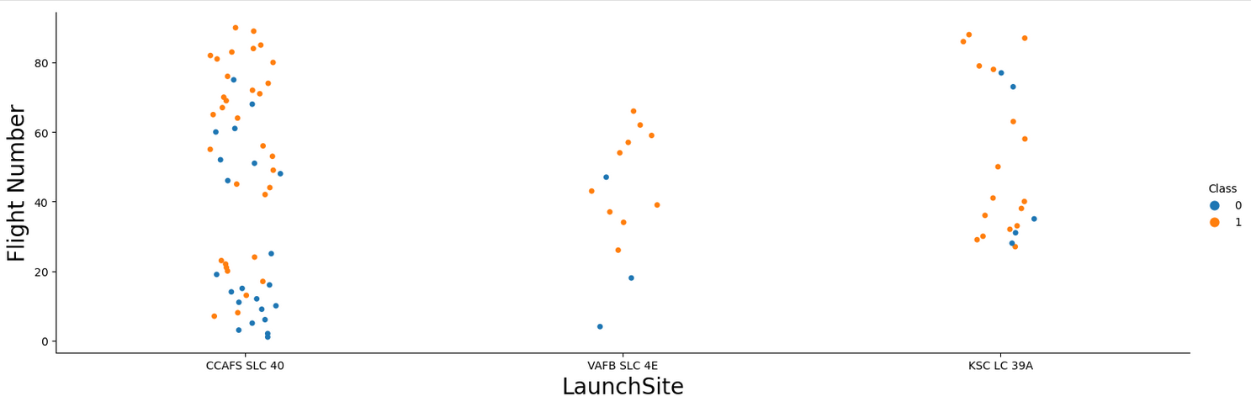
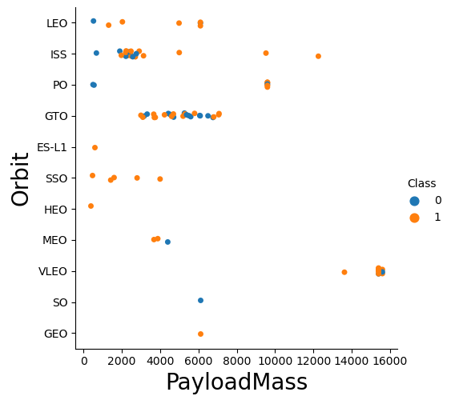
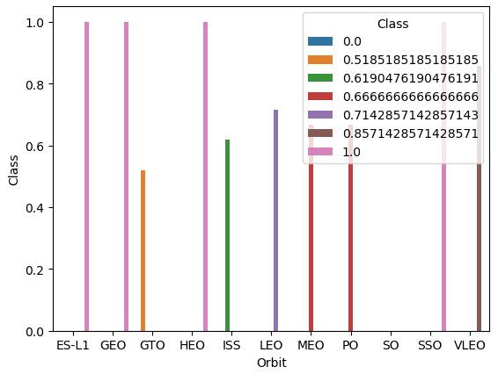
EDA with Data Visualization
Exploratory Data Analysis
Scatter plot for Flight Number vs. Payload Mass, Flight Number vs Launch Site, Payload vs Launch Site, Flight Number vs Orbit type, Payload vs Orbit type
Bar chart for success rate of each orbit type
launch success yearly trend
GitHub URL: https://github.com/miraftab/IBM_Applied_Data_Science_Capstone/blob/main/05_jupyter-labs-eda-dataviz.ipynb

Slide 13
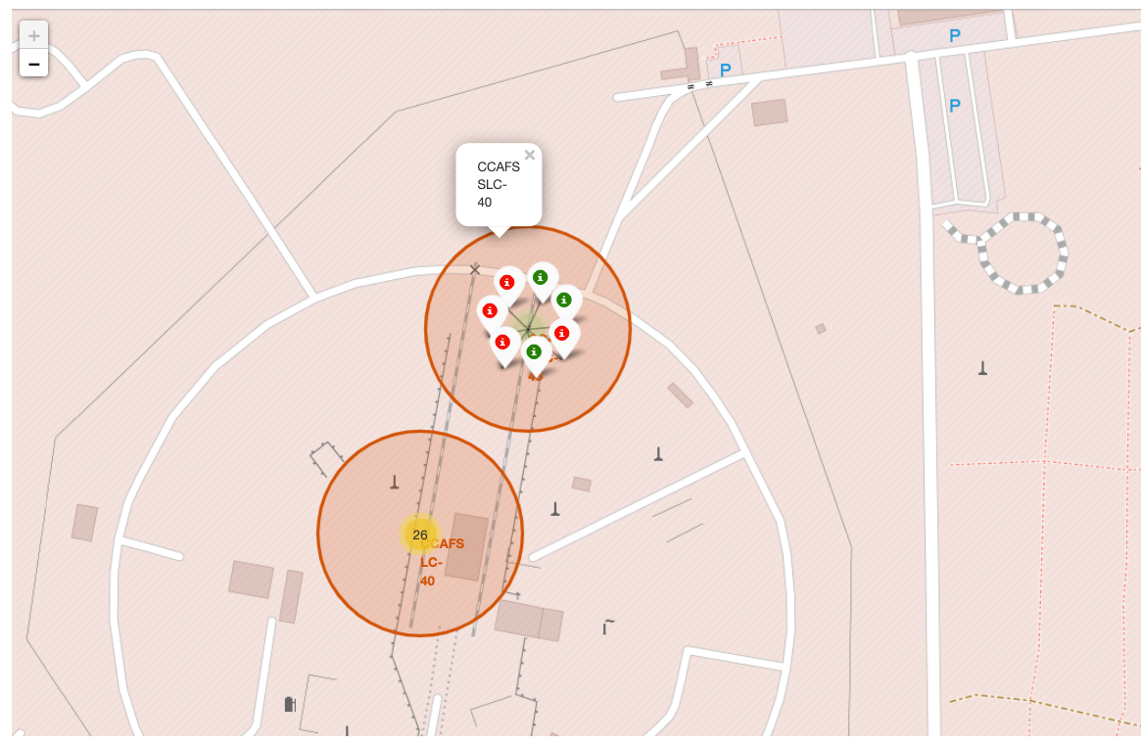
Build an Interactive Map with Folium
We use Folium to create interactive maps and mark all launch sites on a map, mark the success/failed launches for each site on the map and calculate the distances between a launch site to its proximities
GitHub URL:
https://github.com/miraftab/IBM_Applied_Data_Science_Capstone/blob/main/06_lab_jupyter_launch_site_location.ipynb

Slide 14
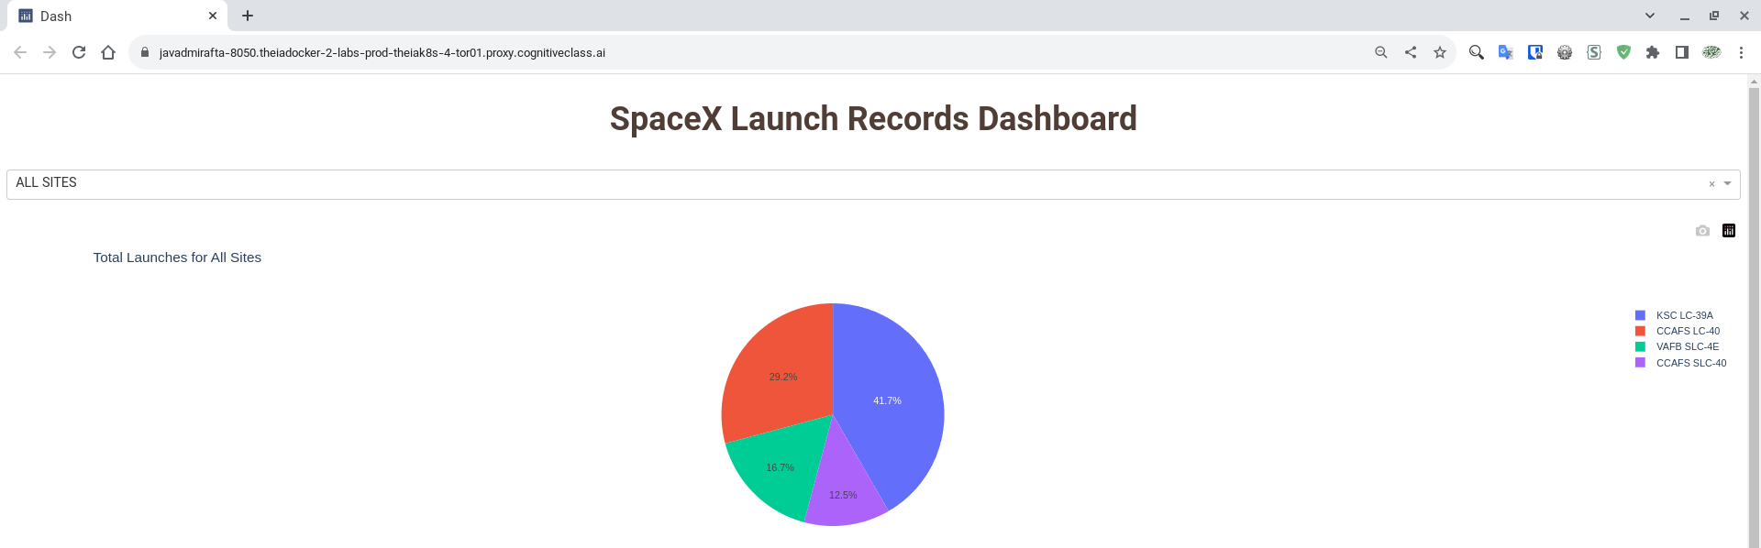
Build a Dashboard with Plotly Dash
We built an interactive dashboard with Plotly dash
We plotted pie charts showing the total launches by a certain sites
We plotted scatter graph showing the relationship with Outcome and Payload Mass (Kg) for the different booster version.
GitHub URL:
https://github.com/miraftab/IBM_Applied_Data_Science_Capstone/blob/main/spacex_dash_app.py

Slide 15
Predictive Analysis (Classification)
We load data, create Pandas Data Frame and using NumPy to create, transform, standardize and split data sets
Then we create different machine learning models to predict result:
logistic regression
support vector machine
decision tree classifier
k nearest neighbors
And calculate the accuracy for each the model
Finally we find the best performing classification tools
GitHub URL:
https://github.com/miraftab/IBM_Applied_Data_Science_Capstone/blob/main/07_SpaceX_Machine%20Learning%20Prediction_Part_5.ipynb

Slide 16
Results
Logistic Regression
tuned hyperparameters :(best parameters) {'C': 0.01, 'penalty': 'l2', 'solver': 'lbfgs'}
Support vector machine
tuned hyperparameters :(best parameters) {'C': 1.0, 'gamma': 0.03162277660168379, 'kernel': 'sigmoid'}
Decision tree classifier
tuned hyperparameters :(best parameters) {'criterion': 'gini', 'max_depth': 6, 'max_features': 'auto', 'min_samples_leaf': 2, 'min_samples_split': 5, 'splitter': 'best'}
K nearest neighbors
tuned hyperparameters :(best parameters) {'algorithm': 'auto', 'n_neighbors': 9, 'p': 1}
Accuracy for Logistics Regression method: 0.8333333333333334
Accuracy for Support Vector Machine method: 0.8333333333333334
Accuracy for Decision tree method: 0.9444444444444444
Accuracy for K nears neighbors method: 0.8333333333333334

Slide 17

Section 2

Slide 18
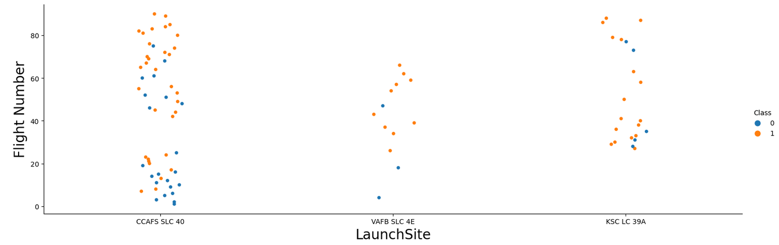
Flight Number vs. Launch Site
The plot shows that the greater flight number have a greater success chance and on the KSK LC 39A most of flight successes.

Slide 19
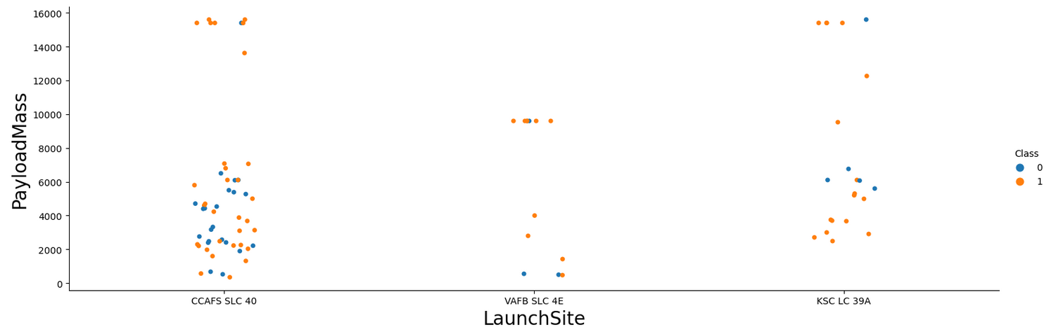
Payload vs. Launch Site
On CCAFS SLC 40 and VAFB SLC 4E the greater Payload Mass have a better success chance
On KSC LC 39A Payload less than 4000 ang greater than 8000 have a better success chance

Slide 20
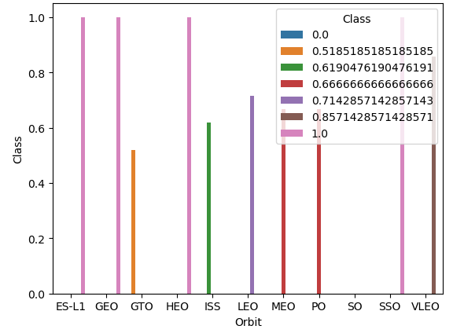
Success Rate vs. Orbit Type
From the plot the ES-L1, GEO, HEO, SSO had the most success rate.
After them VLEO had most success rate
Next success rate are for MEO and PO

Slide 21
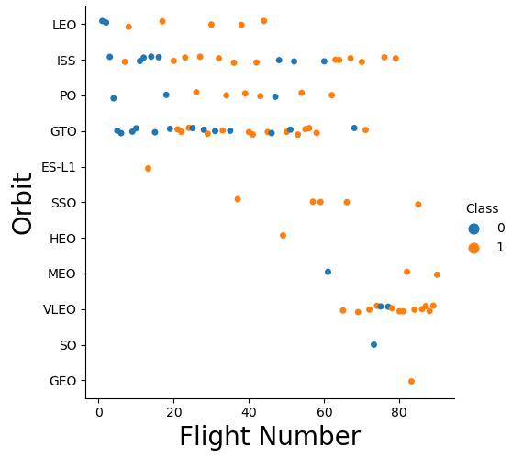
Flight Number vs. Orbit Type
As show on the plot LEO, ISS, PO, VLEO had a better success rate when the Flight number is bigger.
GTO shows no relation between success rate and flight number
ES-L1, SSO, HEO and GEO has no unsuccessful flight
MEO and SO has no successful flight

Slide 22
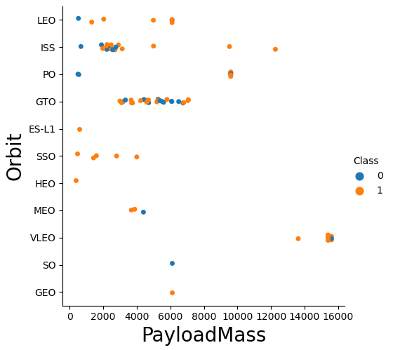
Payload vs. Orbit Type
Most heavy payload is for SSO and HEO
After them ISS and PO have heaviest Payloads

Slide 23
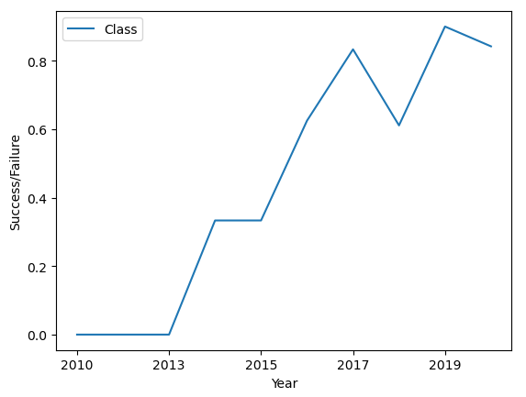
Launch Success Yearly Trend
Average success shows and up trends from 2013 to 2020. It means every year Space-X had more successful landing
There is a gap on 2018, but the trends is to up

Slide 24
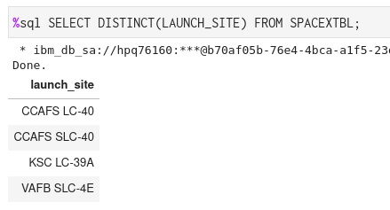
All Launch Site Names
Names of the unique launch sites
CCAFS LC-40
VAFB SLC-4E
KSC LC-39A
CCAFS SLC-40
We use DISTINCT to find the unique names in SQL query

Slide 25
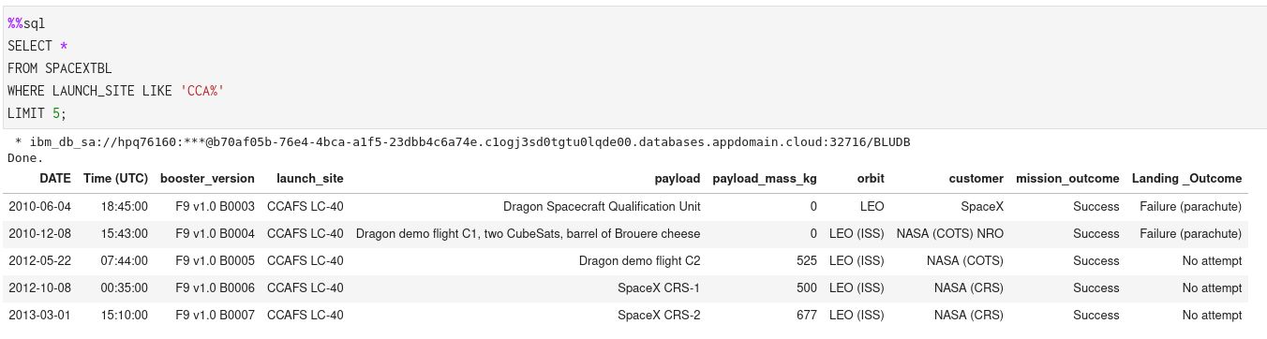
Launch Site Names Begin with 'CCA'
To find 5 records where launch sites begin with `CCA` must can this query:
SELECT * FROM SPACEXTBL WHERE LAUNCH_SITE LIKE 'CCA%' LIMIT 5;

Slide 26
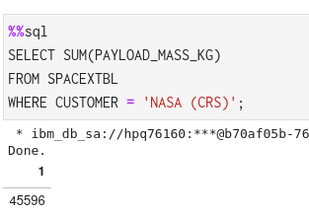
Total Payload Mass
To calculate the total payload carried by boosters from NASA use this query:
SELECT SUM(PAYLOAD_MASS_KG)​
FROM SPACEXTBL​
WHERE CUSTOMER = 'NASA (CRS)';​

Slide 27
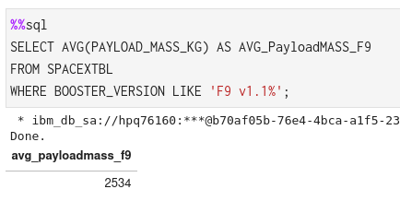
Average Payload Mass by F9 v1.1
Calculate the average payload mass carried by booster version F9 v1.1
SELECT AVG(PAYLOAD_MASS_KG) AS AVG_PayloadMASS_F9 FROM SPACEXTBL WHERE BOOSTER_VERSION LIKE 'F9 v1.1%';

Slide 28
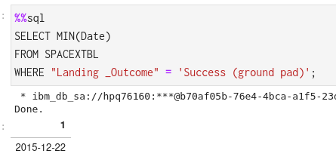
First Successful Ground Landing Date
First successful landing outcome on ground pad was 22nd December 2015

Slide 29
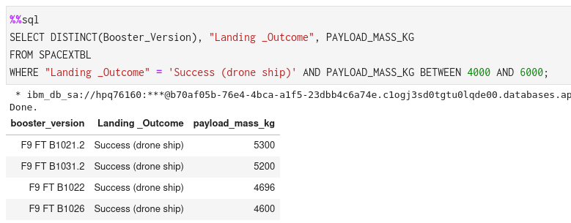
Successful Drone Ship Landing with Payload between 4000 and 6000
We can use this query for Successful Drone Ship Landing with Payload between 4000 and 6000
SELECT DISTINCT(Booster_Version), "Landing _Outcome", PAYLOAD_MASS_KG FROM SPACEXTBL WHERE "Landing _Outcome" = 'Success (drone ship)' AND PAYLOAD_MASS_KG BETWEEN 4000 AND 6000;

Slide 30
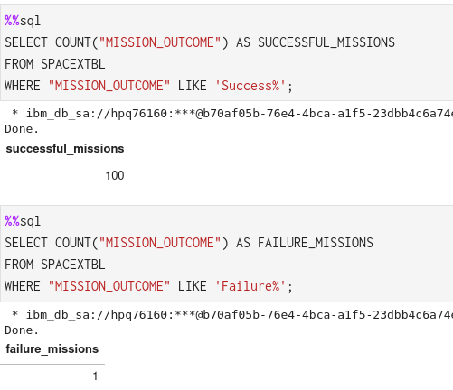
Total Number of Successful and Failure Mission Outcomes
SELECT COUNT("MISSION_OUTCOME") AS SUCCESSFUL_MISSIONS FROM SPACEXTBL WHERE "MISSION_OUTCOME" LIKE 'Success%';
SELECT COUNT("MISSION_OUTCOME") AS FAILURE_MISSIONS FROM SPACEXTBL WHERE "MISSION_OUTCOME" LIKE 'Failure%';

Slide 31
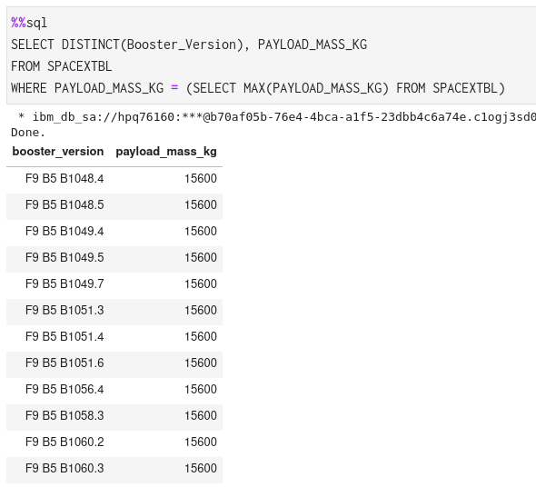
Boosters Carried Maximum Payload
List of the booster which have carried the maximum payload mass (kg)
F9 B5 B1048.4 15600
F9 B5 B1048.5 15600
F9 B5 B1049.4 15600
F9 B5 B1049.5 15600
F9 B5 B1049.7 15600
F9 B5 B1051.3 15600
F9 B5 B1051.4 15600
F9 B5 B1051.6 15600
F9 B5 B1056.4 15600
F9 B5 B1058.3 15600
F9 B5 B1060.2 15600
F9 B5 B1060.3 15600

Slide 32
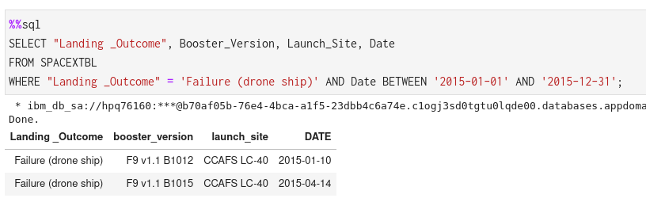
2015 Launch Records
List the failed landing_outcomes in drone ship, their booster versions, and launch site names for in year 2015
Use Where, between asd condition to get the results.
Landing _Outcome booster_version launch_site DATE Failure (drone ship) F9 v1.1 B1012 CCAFS LC-40 2015-01-10 Failure (drone ship) F9 v1.1 B1015 CCAFS LC-40 2015-04-14

Slide 33
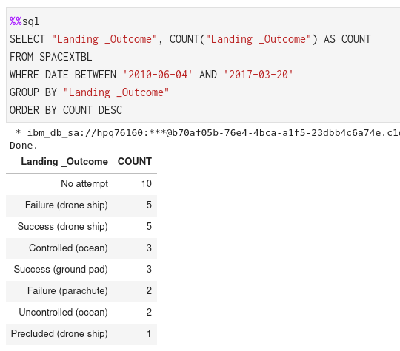
Rank Landing Outcomes Between 2010-06-04 and 2017-03-20
Select Landing outcomes_and the COUNT of landing_outcomes from the data and used the WHERE clause to filter for landing outcomes BETWEEN 2010-06-04 to 2010-03-20.
Then applied the GROUP BY clause to group the landing outcomes and the ORDER BY clause to order the grouped landing outcome in descending order.

Slide 34

Section 3

Slide 35
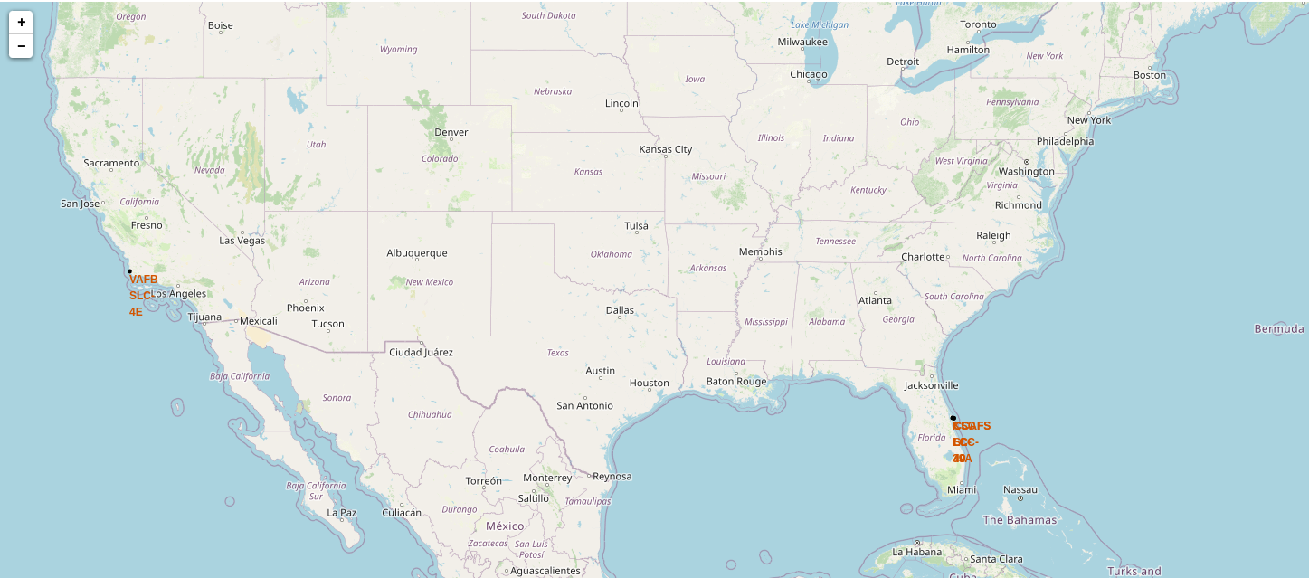
All launch sites on a map
Space-X launch sites are in USA, Florida and California.

Slide 36
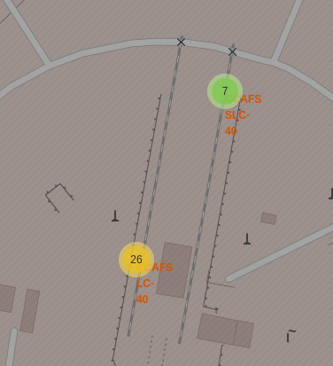
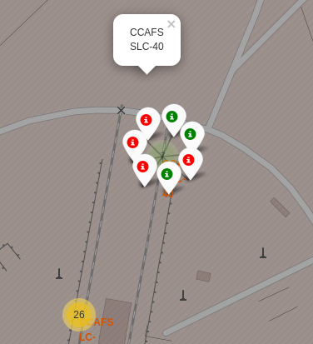
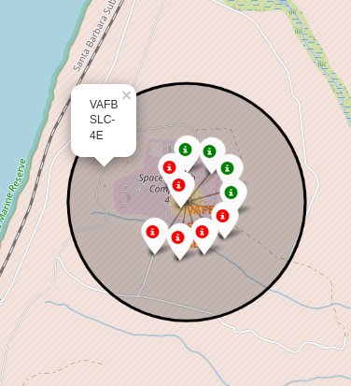
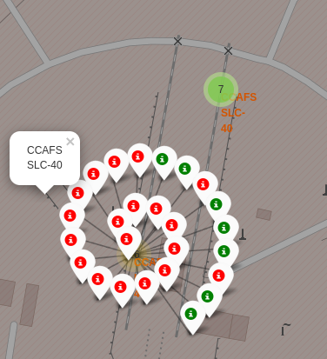
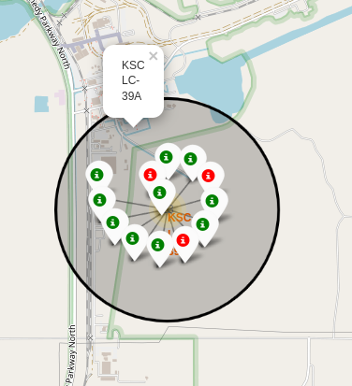
Show the color-labeled launch outcomes on the map
Green Marker shows successful launches and Red Marker shows failure
California Launch Sites
Florida Launch Sites

Slide 37
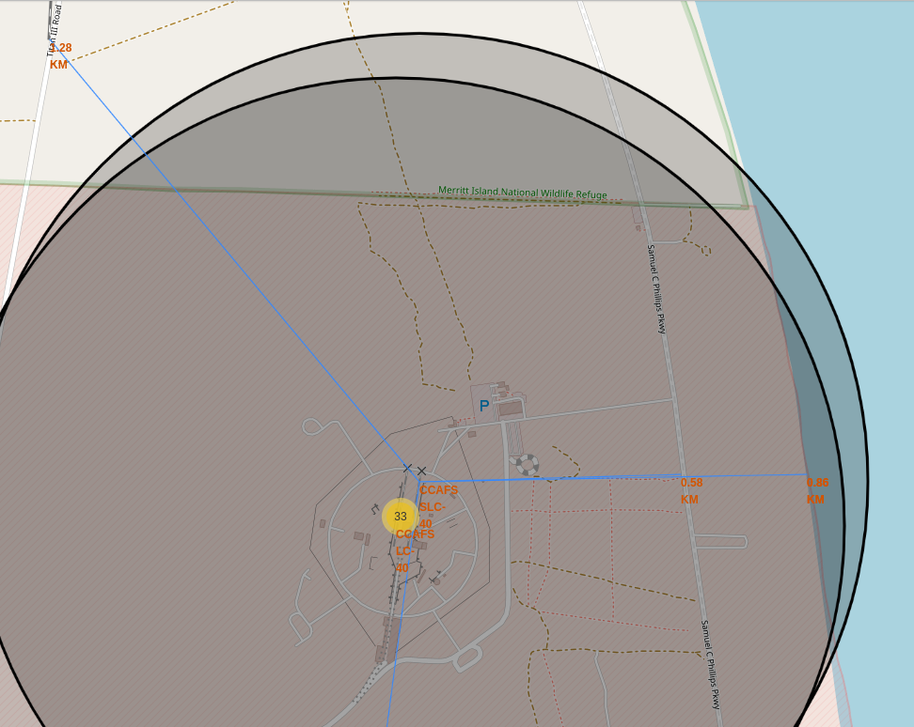
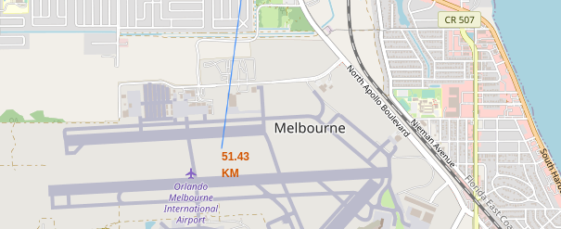
Launch Site distance to landmarks
Distance to Orlando Melborn Internation Airport: 51.43 KM
Distance to Nisara Railroad: 1.28 KM
Distance to Samuel C Philips PKwy: 0.58 KM
Distance to coastline: 0.86 KM

Slide 38

Section 4

Slide 39
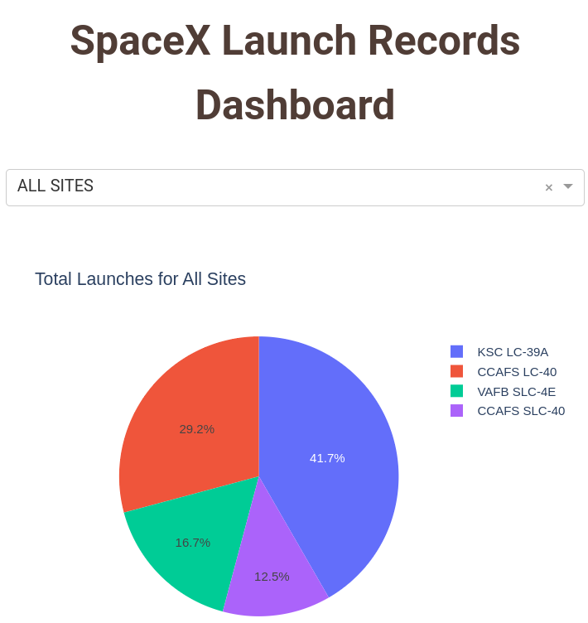
Pie chart to shoe all sites launch success
We see the KSC LC-39A has the most successful launches in all sites
Second place is for CCAFS LC-40
Third is VAFB SLC-4E
Forth is CCAFS SLC-40

Slide 40
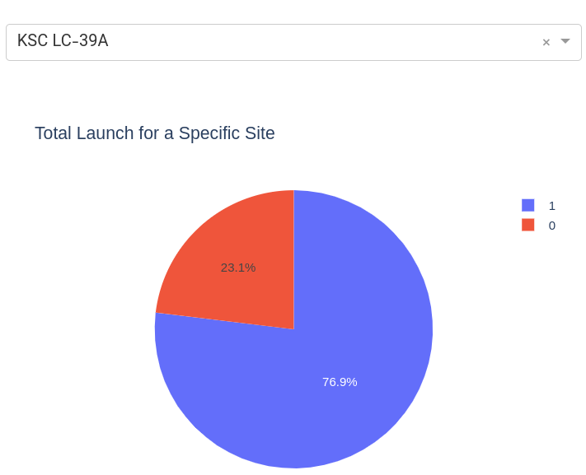
KSC LC-39A pie chart success vs failure
KSC LC-39A has 76.9% success ratio

Slide 41
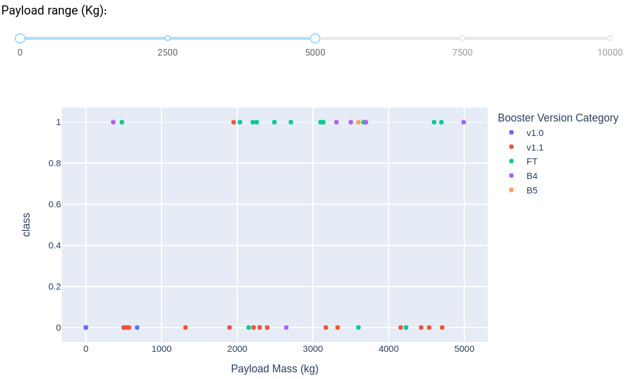
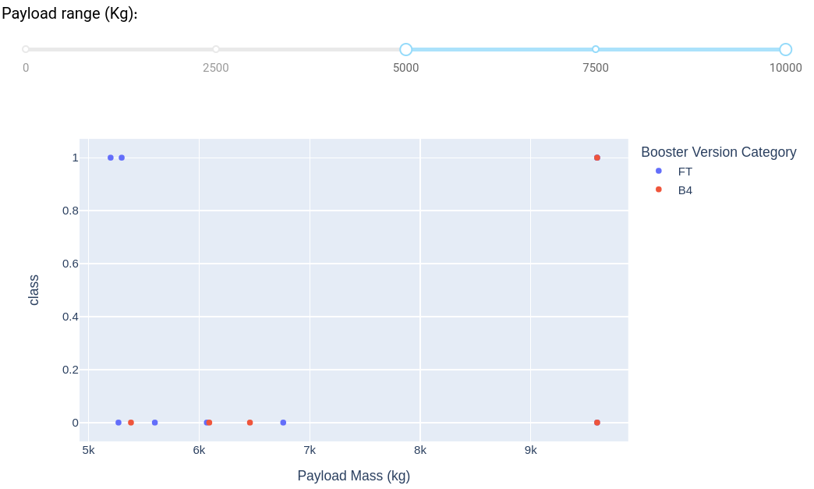
Scatter plot of Payload vs Launch Outcome for all sites
Scatter plot of payload vs launch outcome for all sites with different payload in range slider.
We see the success rate for low weighted payloads is higher than the heavy weighted payloads
Low weighted payloads: 0 – 5000 kg
High weighted payloads: 5000 – 10000 kg

Slide 42

Section 5

Slide 43
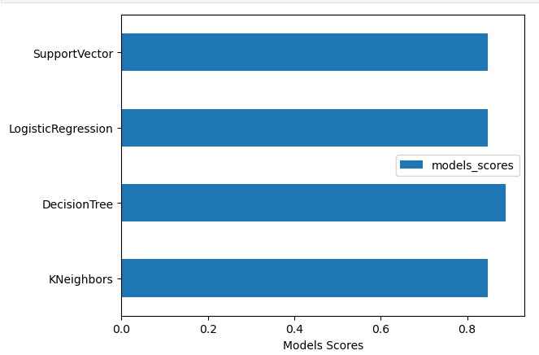
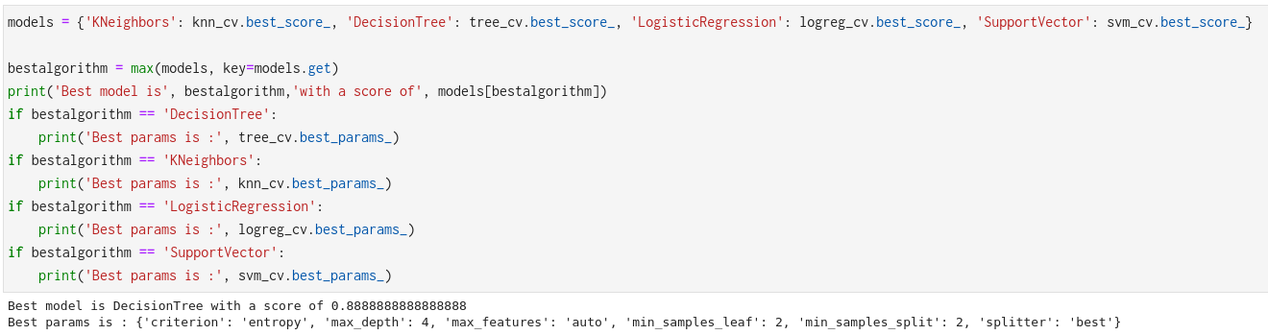
Classification Accuracy
The Decision Tree has the best accuracy with 0.88

Slide 44
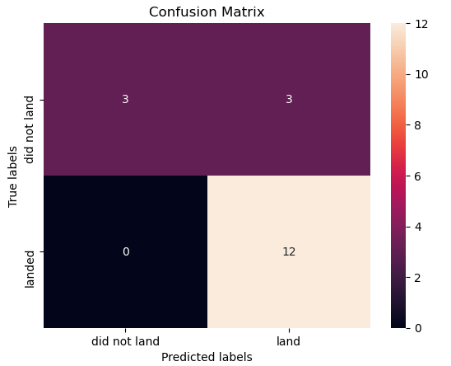
Confusion Matrix
The confusion matrix for the decision tree classifier shows that the classifier can distinguish between the different classes.
The major problem is the false positives .i.e., unsuccessful landing marked as successful landing by the classifier.

Slide 45
Conclusions
Larger flight amount at launch site has the greater success rate
from 2013 succes rates increase yearly in Space-X
ES-L1, GEO, HEO, SSO, VLEO orbits has the most succes rates
KSC LC-39A had the most successful launches in all sites
The Decision tree classifier is the best machine learning algorithm for this task.

Slide 46
Appendix
All codes are available in github:
https://github.com/miraftab/IBM_Applied_Data_Science_Capstone.git
Interactive maps does not display on the github.com, so you can see that notrbook map here:
https://nbviewer.org/github/miraftab/IBM_Applied_Data_Science_Capstone/blob/main/06_lab_jupyter_launch_site_location.ipynb

Slide 47


